Slide 1
C Legacy Code Topics
Compiler Directives
Variable-Length Argument Lists
Using Command-Line Arguments
Program Termination with exit and atexit
Signal Handling
The Unconditional Branch: goto
Unions
Formatted I/O: printf and scanf

Slide 2
The C Preprocessor
preprocessing
  occurs before a program is compiled.
  inclusion of other files
  definition of symbolic constants and macros,
  conditional compilation of program code
  conditional execution of preprocessor directives
Format of preprocessor directives:
  lines begin with #
  only whitespace characters before directives on a line
  they are not C++ statements - no semicolon (;)

Slide 3
The #include Preprocessor Directive
#include
  copy of a specified file included in place of the directive
  #include <filename> - searches standard library for file (use for standard library files)
  #include "filename" - searches current directory, then standard library (use for user-defined files)
Used for
  loading header files (#include <iostream>)
  programs with multiple source files to be compiled together
  header file - has common declarations and definitions (classes, structures, function prototypes)
    #include statement in each file

Slide 4
The #define Preprocessor Directive: Symbolic Constants
#define
  preprocessor directive used to create symbolic constants and macros.
Symbolic constants
  when program compiled, all occurrences of symbolic constant replaced with replacement text
Format: #define identifier replacement-text
  Example: #define PI 3.14159
  everything to right of identifier replaces text
  #define PI = 3.14159
    replaces "PI" with " = 3.14159", probably results in an error
  cannot redefine symbolic constants with more #define statements

Slide 5
The #define Preprocessor Directive: Macros
Macro - operation defined in #define
  intended for C programs
  macro without arguments: treated like a symbolic constant
  macro with arguments: arguments substituted for replacement text, macro expanded
  performs a text substitution - no data type checking
  Example:
  #define CIRCLE_AREA( x ) ( PI * ( x ) * ( x ) )
  area = CIRCLE_AREA( 4 );
  becomes
  area = ( 3.14159 * ( 4 ) * ( 4 ) );

Slide 6
The #define Preprocessor Directive: Macros
use parentheses:
  without them,
  #define CIRCLE_AREA( x ) PI * ( x ) * ( x )
  area = CIRCLE_AREA( c + 2 );
  becomes
  area = 3.14159 * c + 2 * c + 2;
  which evaluates incorrectly
multiple arguments:
  #define RECTANGLE_AREA( x, y ) ( ( x ) * ( y ) )
  rectArea = RECTANGLE_AREA( a + 4, b + 7 );
  becomes
  rectArea = ( ( a + 4 ) * ( b + 7 ) );
#undef
  undefines a symbolic constant or macro, which can later be redefined

Slide 7
Conditional Compilation
At compile time
  control preprocessor directives and compilation
  cast expressions, sizeof, enumeration constants cannot be evaluated
structure similar to if
  #if !defined( NULL )
  #define NULL 0
  #endif
  determines if symbolic constant NULL defined
    if NULL is defined, defined(NULL) evaluates to 1
    if NULL not defined, defines NULL as 0
  every #if ends with #endif
  #ifdef short for #if defined(name)
  #ifndef short for #if !defined(name)

Slide 8
Conditional Compilation
Other statements:
  #elif - equivalent of else if in an if structure
  #else - equivalent of else in an if structure
"Comment out" code
  cannot use /* ... */
  use
    #if 0
      code commented out
    #endif
  to enable code, change 0 to 1

Slide 9
A Debug Macro
#define DEBUG_ON
#define NO_MESSAGES 0
#define FATAL_ERROR 1
#define WARNING_ERROR 2
#define TRACE 3
int DebugLevel FATAL_ERROR;
#ifdef DEBUG_ON
#define DEBUG (level, msg) \
{ if (level <= DebugLevel) cout << msg; }
#else
#define DEBUG
#endif

Slide 10
The #error and #pragma Preprocessor Directives
#error tokens
  tokens - sequences of characters separated by spaces
    "I like C++" has 3 tokens
  prints message and tokens (depends on implementation)
  for example: when #error encountered, tokens displayed and preprocessing stops (program does not compile)
#pragma tokens
  implementation defined action (consult compiler documentation)
  pragmas not recognized by compiler are ignored

Slide 11
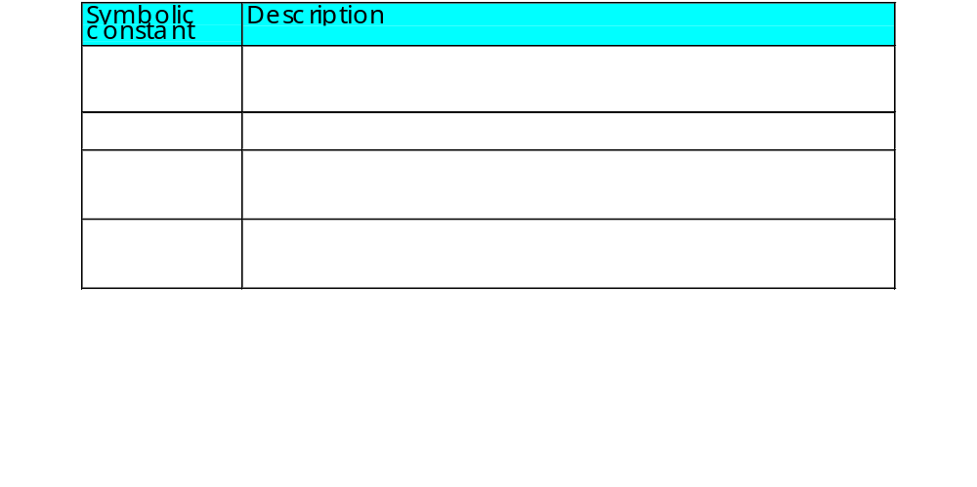
Predefined Symbolic Constants
Five predefined symbolic constants
  cannot be used in #define or #undef

Slide 12
Variable-Length Argument Lists
In C++, we use function overloading
  Variable length argument lists for programmers working with C Legacy Code
Functions with unspecified number of arguments
  include <cstdarg>
  use ellipsis (...) at end of parameter list
  need at least one defined parameter
  double myfunction (int i, ...);
  prototype with variable length argument list

Slide 13
Variable-Length Argument Lists
Macros and declarations in function definition
  va_list - type specifier, required (va_list arguments;)
  va_start(arguments, other variables)
  - intializes parameters, required before use
  va_arg(arguments, type) - returns a parameter each time va_arg is called. Automatically points to next parameter.
  va_end(arguments) - helps function have a normal return

Slide 14
1 // Fig. 18.2: fig18_02.cpp
2 // Using variable-length argument lists
3 #include <iostream>
4
1. Load <cstdarg> header
1.1 Function prototype (variable length argument list)
1.2 Initialize variables
5 using std::cout;
6 using std::endl;
7 using std::ios;
8
9 #include <iomanip>
10
11 using std::setw;
12 using std::setprecision;
13 using std::setiosflags;
14
15 #include <cstdarg>
16
17 double average( int, ... );
18
19 int main()
20 {
21 double w = 37.5, x = 22.5, y = 1.7, z = 10.2;
22
23 cout << setiosflags( ios::fixed | ios::showpoint )
24 << setprecision( 1 ) << "w = " << w << "\nx = " << x

Slide 15
25 << "\ny = " << y << "\nz = " << z << endl;
26 cout << setprecision( 3 ) << "\nThe average of w and x is "
27 << average( 2, w, x )
28 << "\nThe average of w, x, and y is "
29 << average( 3, w, x, y )
2. Function calls
3. Function definition
3.1 Create ap (va_list object)
3.2 Initialize ap (va_start(ap, i))
3.3 Access arguments
va_arg(ap, double)
3.4 End function
va_end(ap);
return total/1;
Program Output
30 << "\nThe average of w, x, y, and z is "
31 << average( 4, w, x, y, z ) << endl;
32 return 0;
33 }
34
35 double average( int i, ... )
36 {
37 double total = 0;
38 va_list ap;
39
40 va_start( ap, i );
41
42 for ( int j = 1; j <= i; j++ )
43 total += va_arg( ap, double );
44
45 va_end( ap );
46
47 return total / i;
48 }
w = 37.5
x = 22.5
y = 1.7
z = 10.2
The average of w and x is 30.000
The average of w, x, and y is 20.567
The average of w, x, y, and z is 17.975

Slide 16
Using Command-Line Arguments
Pass arguments to main in DOS and UNIX
  int main( int argc, char *argv[] )
  int argc - number of arguments passed
  char *argv[] - array of strings, has names of arguments in order (argv[0] is first argument)
  Example: $ copy input output
  argc: 3
  argv[0]: "copy"
  argv[1]: "input"
  argv[2]: "output"

Slide 17
1 // Fig. 18.3: fig18_03.cpp
2 // Using command-line arguments
3 #include <iostream>
Copy a file into another
1. Load headers
1.1 Initialize variables
2. Check number of parameters
2.1 Link ifstream object with input file.
4
5 using std::cout;
6 using std::endl;
7 using std::ios;
8
9 #include <fstream>
Notice argc and argv[] in main
10
11 using std::ifstream;
12 using std::ofstream;
13
14 int main( int argc, char *argv[] )
15 {
argv[1] is the second argument
16 if ( argc != 3 )
17 cout << "Usage: copy infile outfile" << endl;
18 else {
19 ifstream inFile( argv[ 1 ], ios::in );
20
21 if ( !inFile ) {

Slide 18
22 cout << argv[ 1 ] << " could not be opened" << endl;
23 return -1;
argv[2] is the third argument
24 }
2.2 Link ofstream object with output file.
2.3 Copy input to output, character by character.
25
26 ofstream outFile( argv[ 2 ], ios::out );
27
28 if ( !outFile ) {
29 cout << argv[ 2 ] << " could not be opened" << endl;
30 inFile.close();
31 return -2;
32 }
Loop until End Of File. get a character from inFile and put it into outFile.
33
34 while ( !inFile.eof() )
35 outFile.put( static_cast< char >( inFile.get() ) );
36
37 inFile.close();
38 outFile.close();
39 }
40
41 return 0;
42 }

Slide 19
Program Termination with exit and atexit
function exit - forces a program to terminate
  parameters - symbolic constants EXIT_SUCCESS or EXIT_FAILURE
  returns implementation-defined value
  exit(EXIT_SUCCESS);
function atexit
  atexit(functionToRun); - registers functionToRun to execute upon successful program termination
    atexit itself does not terminate the program
    register up to 32 functions (multiple atexit() statements)
    functions called in reverse register order
    called function cannot take arguments or return values

Slide 20
1 // Fig. 18.4: fig18_04.cpp
2 // Using the exit and atexit functions
3 #include <iostream>
4
5 using std::cout;
1. Register function print using atexit
2. User input
3. Output
3.1 Function definition
6 using std::endl;
7 using std::cin;
8
9 #include <cstdlib>
10
11 void print( void );
12
13 int main()
14 {
15 atexit( print ); // register function print
16 cout << "Enter 1 to terminate program with function exit"
17 << "\nEnter 2 to terminate program normally\n";
18
19 int answer;
20 cin >> answer;
21
22 if ( answer == 1 ) {
23 cout << "\nTerminating program with function exit\n";
24 exit( EXIT_SUCCESS );
25 }
26
27 cout << "\nTerminating program by reaching the end of main"
28 << endl;
29
30 return 0;
31 }
32
33 void print( void )

Slide 21
34 {
35 cout << "Executing function print at program termination\n"
36 << "Program terminated" << endl;
3.1 Function definition
Program Output
37 }
Enter 1 to terminate program with function exit
Enter 2 to terminate program normally
: 1
Terminating program with function exit
Executing function print at program termination
Program terminated
Enter 1 to terminate program with function exit
Enter 2 to terminate program normally
: 2
Terminating program by reaching the end of main
Executing function print at program termination
Program terminated

Slide 22
Signal Handling
signal
  an unexpected event, can terminate program
    interrupts (<ctrl> c), illegal instructions, segmentation violations, termination orders, floating-point exceptions (division by zero, multiplying large floats)
function signal traps unexpected events
  header <csignal>
  two arguments: signal number, pointer to function to handle it
function raise
  takes in integer signal number and creates signal

Slide 23
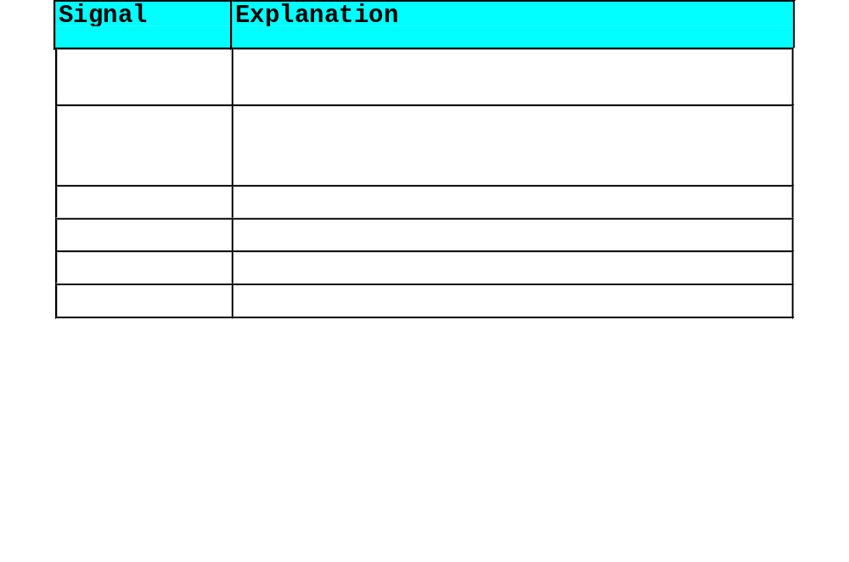
Signal Handling

Slide 24
Signal Handling
Dynamic memory allocation
  can create dynamic arrays
calloc(nmembers, size)
  nmembers - number of members
  size - size of each member
  returns pointer to dynamic array
realloc(pointerToObject, newSize)
  pointerToObject - pointer to the object being reallocated
  newSize - new size of the object
  returns pointer to reallocated memory
  returns NULL if cannot allocate space
  if newSize = 0, object freed
  if pointerToObject = 0, acts like malloc

Slide 25
1 // Fig. 18.6: fig18_06.cpp
2 // Using signal handling
3 #include <iostream>
4
5 using std::cout;
1. Function prototype
2. Generate random number
2.1 raise signal if x == 25
6 using std::cin;
7 using std::endl;
8
9 #include <iomanip>
10
11 using std::setw;
12
13 #include <csignal>
signal set to call function signal_handler when a signal of type SIGINT occurs.
14 #include <cstdlib>
15 #include <ctime>
16
17 void signal_handler( int );
1 2 3 4 5 6 7 8 9 10
11 12 13 14 15 16 17 18 19 20
21 22 23 24 25 26 27 28 29 30
31 32 33 34 35 36 37 38 39 40
41 42 43 44 45 46 47 48 49 50
51 52 53 54 55 56 57 58 59 60
61 62 63 64 65 66 67 68 69 70
71 72 73 74 75 76 77 78 79 80
81 82 83 84 85 86 87 88
18
19 int main()
20 {
21 signal( SIGINT, signal_handler );
22 srand( time( 0 ) );
23
24 for ( int i = 1; i < 101; i++ ) {
25 int x = 1 + rand() % 50;
26
Interrupt signal (4) received.
Do you wish to continue (1 = yes or 2 = no)? 1
27 if ( x == 25 )
28 raise( SIGINT );
29
30 cout << setw( 4 ) << i;
89 90
91 92 93 94 95 96 97 98 99 100
31
32 if ( i % 10 == 0 )
33 cout << endl;
34 }

Slide 26
35
36 return 0;
37 }
38
3. Function definition
39 void signal_handler( int signalValue )
40 {
41 cout << "\nInterrupt signal (" << signalValue
User given option of terminating program
42 << ") received.\n"
43 << "Do you wish to continue (1 = yes or 2 = no)? ";
44
45 int response;
46 cin >> response;
47
48 while ( response != 1 && response != 2 ) {
49 cout << "(1 = yes or 2 = no)? ";
signal handler reinitialized by calling signal again
50 cin >> response;
51 }
52
53 if ( response == 1 )
54 signal( SIGINT, signal_handler );
55 else
56 exit( EXIT_SUCCESS );
57 }

Slide 27
1 2 3 4 5 6 7 8 9 10
11 12 13 14 15 16 17 18 19 20
21 22 23 24 25 26 27 28 29 30
31 32 33 34 35 36 37 38 39 40
41 42 43 44 45 46 47 48 49 50
51 52 53 54 55 56 57 58 59 60
61 62 63 64 65 66 67 68 69 70
71 72 73 74 75 76 77 78 79 80
81 82 83 84 85 86 87 88
Interrupt signal (4) received.
Do you wish to continue (1 = yes or 2 = no)? 1
89 90
91 92 93 94 95 96 97 98 99 100
Program Output

Slide 28
The Unconditional Branch: goto
unstructured programming
  use when performance crucial
  break to exit loop instead of waiting until condition becomes false
goto statement
  changes flow control to first statement after specified label
  label: identifier and colon (i.e. start:)
  quick escape from deeply nested loop
  goto start;

Slide 29
1 // Fig. 18.7: fig18_07.cpp
2 // Using goto
3 #include <iostream>
4
1. Initialize variables
1.1 start: label
2. Loop using goto
3. Output
Program Output
5 using std::cout;
6 using std::endl;
Notice how start: , end: and goto are used
7
8 int main()
9 {
10 int count = 1;
11
12 start: // label
13 if ( count > 10 )
14 goto end;
15
16 cout << count << " ";
17 ++count;
18 goto start;
19
20 end: // label
21 cout << endl;
22
23 return 0;
24 }
1 2 3 4 5 6 7 8 9 10

Slide 30
Unions
union - memory that contains a variety of objects over time
  only contains one data member at a time
  members of a union share space
  conserves storage
  only the last data member defined can be accessed
union declarations
  same as class or struct
    union Number {
    int x;
    float y;
    } ;
    Union myObject;

Slide 31
Unions
Valid union operations
  assignment to union of same type: =
  taking address: &
  accessing union members: .
  accessing members using pointers: ->
Anonymous unions
  no type name
  does not create a type, but does create an unnamed object
  contains only public data members
  data members accessed like normal variables
    use name, no . or -> required
  if declared globally, must be static

Slide 32
1 // Fig. 18.8: fig18_08.cpp
2 // An example of a union
3 #include <iostream>
4
1. Declare union
1.1 Declare union object
1.2 Initialize variable
2. Set variables
3. Output
5 using std::cout;
6 using std::endl;
7
8 union Number {
9 int x;
10 double y;
11 };
12
13 int main()
Put a value in the integer member
and print both members.
int: 100
double: -9.25596e+061
14 {
15 Number value;
16
17 value.x = 100;
Put a value in the floating member
and print both members.
int: 0
double: 100
18 cout << "Put a value in the integer member\n"
19 << "and print both members.\nint: "
20 << value.x << "\ndouble: " << value.y << "\n\n";
21
22 value.y = 100.0;
23 cout << "Put a value in the floating member\n"
24 << "and print both members.\nint: "
25 << value.x << "\ndouble: " << value.y << endl;
26 return 0;
27 }

Slide 33
Put a value in the integer member
and print both members.
int: 100
double: -9.25596e+061
Put a value in the floating member
and print both members.
int: 0
double: 100
The internal representation of integers and floats can vary greatly.
Program Output
Integer value not preserved when the float is set.

Slide 34
Formatted I/O
Writing: printf()
Reading (parsing): scanf()
Notes:
Now we will discuss input and output of strings in Windows with C++. We will look at these two functions, wsprintf and sscanf.

Slide 35
printf()
int printf (const char *format, ...);
int fprintf (FILE *fp, const char *format, …);
int sprintf (char *buf, const char *format, …);
format specifies the formatting of the arguments using predefined specifiers
... Specifies one or more optional arguments. The number and type of argument parameters depends on the corresponding format‑control specifications in the format parameter.
Return Values - If the function succeeds, the return value is the number of characters stored in the output buffer, not counting the terminating null character.

Slide 36
Using printf
Int My_Age = 29;
printf (“My age is %d”, My_Age);
Notes:
wsprintf writes to the string str,
MessageBox creates the message box with the string that was just created.
(This is an excerpt from the full example in the notes in the function WindowFunc)

Slide 37
printf() - Format specification
General form: %[‑][#][0][width][.precision]type
Field Meaning
- Pad the output with blanks or zeros to the right to fill the field
width, justifying output to the left. If this field is omitted, the
output is padded to the left, justifying it to the right.
# Prefix hexadecimal values with 0x (lowercase) or 0X (uppercase).
0 Pad the output value with zeros to fill the field width. If this field
is omitted, the output value is padded with blank spaces.

Slide 38
Format Specifications con’t
width Copy the specified minimum number of characters to the output buffer.
The width field is a nonnegative integer. The width specification never
causes a value to be truncated.
.precision For numbers, copy the specified minimum number of digits to the output
buffer. If the number of digits in the argument is less than the specified
precision, the output value is padded on the left with zeros. The value is
not truncated when the number of digits exceeds the specified precision.
If the specified precision is 0 or omitted entirely, or if the period (.)
appears without a number following it, the precision is set to 1. For
strings, copy the specified maximum number of characters to the
output buffer.
type Output the corresponding argument as a character, a string, or a number.

Slide 39
Format Specifications con’t
    c A single character.
    d A signed decimal integer argument.
    ld A long signed decimal integer.
    lu A long unsigned integer.
    lx, lX A long unsigned hexadecimal integer in lowercase or
    uppercase.
    s A string.
    u An unsigned integer argument.
    x, X An unsigned hexadecimal integer in lowercase or
    uppercase.
Notes:
These formats describe how to represent numbers in output.

Slide 40
scanf() - Parsing input
int scanf( const char *format [, argument ] ... );
int fscanf( FILE *fp, const char *format [, argument ] ... );
int sscanf( char *buf, const char *format [, argument ] ... );
buffer: Stored data
format: Format-control string
argument: Optional arguments
Return Value is the number of fields successfully converted and assigned; the return value does not include fields that were read
but not assigned. A return value of 0 indicates that no fields were
assigned. The return value is EOF for an error or if the end of the
file or string is reached before the first conversion.
Notes:
Wide character windows version: swscanf()

Slide 41
Format Control String
The format control string specifies the interpretation of the
input and can contain one or more of the following:
·White-space characters: blank (' '); tab ('\t'); or newline ('\n'),
these cause scanf to skip to the next non–white‑space character.
·Non–white-space characters, except for the percent sign (%),
cause scanf to read, but not store, a matching non–white-space
character. If the next character in stdin does not match, scanf terminates.
Typically used for matching text.
·Format specifications, introduced by the percent sign (%), read and
convert characters in the input into values of a specified type,
assigned to an argument in the argument list.

Slide 42
Format Specifications for scanf()
A format specification has the following form (abbreviated):
%[*] [width] type
* - suppresses assignment of the next input field
width - maximum number of characters to be read
type - specifies type of input expected

Slide 43
Format specification types
Character Type of Input Expected Type of Argument
c Single character pointer to char
d Decimal integer pointer to int
i Decimal, hex, or octal integer pointer to int
o Octal integer pointer to int
u Unsigned decimal integer ptr to unsigned int
x Hexadecimal integer ptr to int
e,E,f,g,G floating values and exponents pointer to float
n No input read from stream pointer to int, which
stores # of chars read
s String, up to first whitespace char array large enough
character (space, tab, newline) for input field plus
terminating character
Notes:
These formats are used to parse input strings.
Why do the parameters need to be *pointers* to
variables? (C’s copy by value and copy by reference, if not a pointer then can’t change the value
of the parameter, and therefore cannot read into it.)

Slide 44
sscanf() - Example
/* SSCANF.C: This console program uses sscanf to read data items
* from a string named tokenstring, then displays them.
*/
#include <stdio.h>
void main( void )
{
char tokenstring[] = "15 12 14...";
char s[81];
char c;
int i;
float fp;
/* Input various data from tokenstring: */
sscanf( tokenstring, "%s", s );
sscanf( tokenstring, "%c", &c );
sscanf( tokenstring, "%d", &i );
sscanf( tokenstring, "%f", &fp );
Notes:
This program scans the character array tokenstring
with different formats, and then outputs them so
we can see the differences.
Here we show the parsing of the tokenstring.

Slide 45
sscanf Example con’t
/* Output the data read */
printf( "String = %s\n", s );
printf( "Character = %c\n", c );
printf( "Integer: = %d\n", i );
printf( "Real: = %f\n", fp );
}
Output
String = 15
Character = 1
Integer: = 15
Real: = 15.000000
Notes:
Here we show the output with normal printf,
and the results.
String reads until the first whitespace char.
Character just takes the first character (NOT AN
INTEGER READ HERE… it’s the character 1)
Integer takes the characters until whitespace and interprets them as numbers.
Real does the same, although the representation is floating point.

